Slide 1
CONSTRUCTION

Slide 2
The development company GREEN SIDE is a construction company founded in 2007. The company has implemented four projects in Imereti - Kutaisi. Positions itself as one of the premium quality construction company. Green Side - this is a concept, complete comfort in one residential complex. We offer the highest quality, environmentally friendly product, the analogue of which is not on the market at this stage. Our logo is an expression of this purity and serenity.

Slide 3
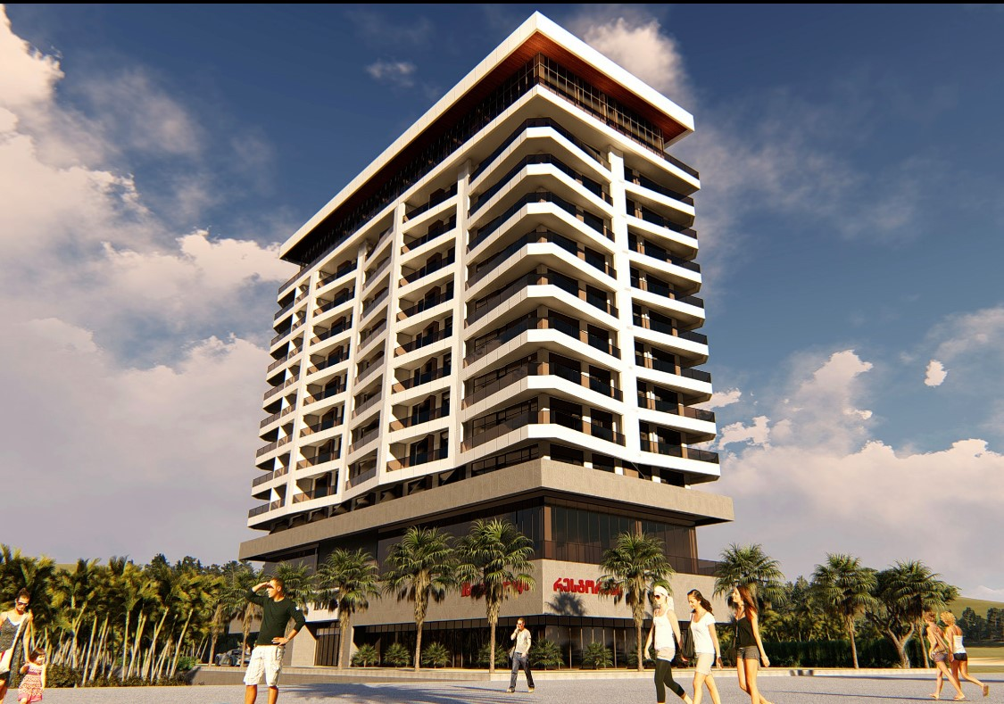
Our current project Green Side Gonio is located on the beach of Gonio-Kvariati, 50 meters from the sea, in the first lane. There are 121 apartments in the complex, the apartaments are available from 25 sq.m. to 82 sq.m. The apartments in Green Side Gonio are fully renovated, with furniture and appliances.

Slide 4
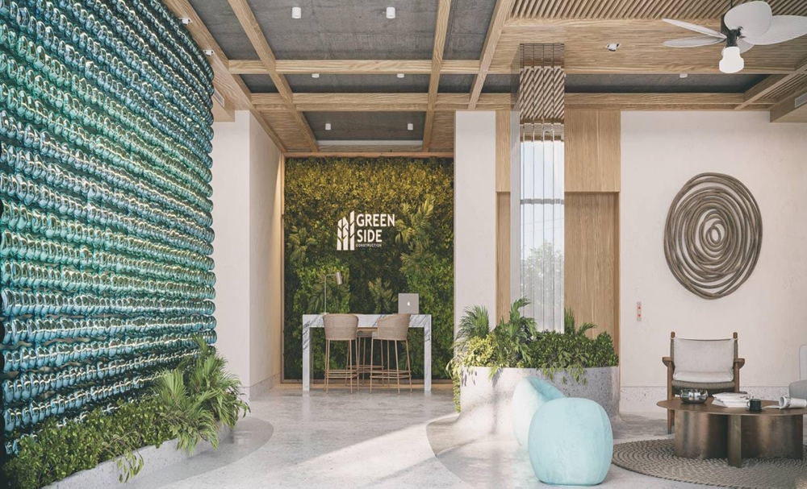
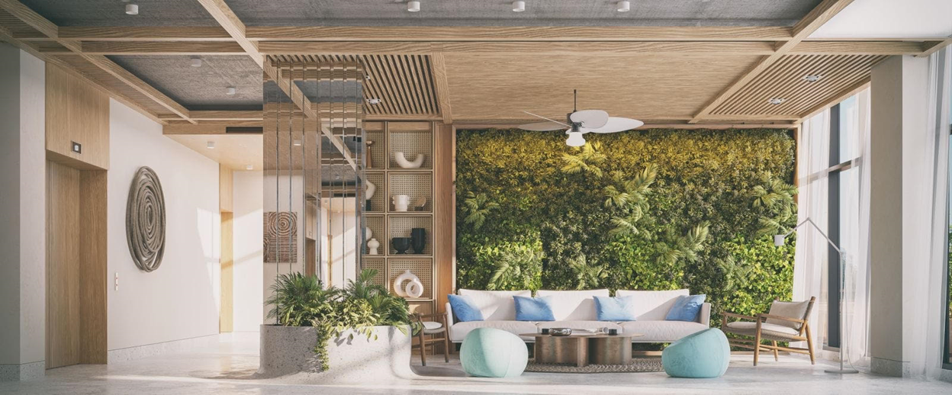
Apartments in Green Side Gonio guarantee your steady income. Live and relax in your apartments, and in your absence we will take care of renting your apartments ourselves.

Slide 5
Green Side infrastructure includes: • Outdoor and indoor pool • Spa and fitness center • Restaurant-lounge • Summer terrace • Various entertainment spaces • Open and closed parking • Recreation area 3500 square meters

Slide 6
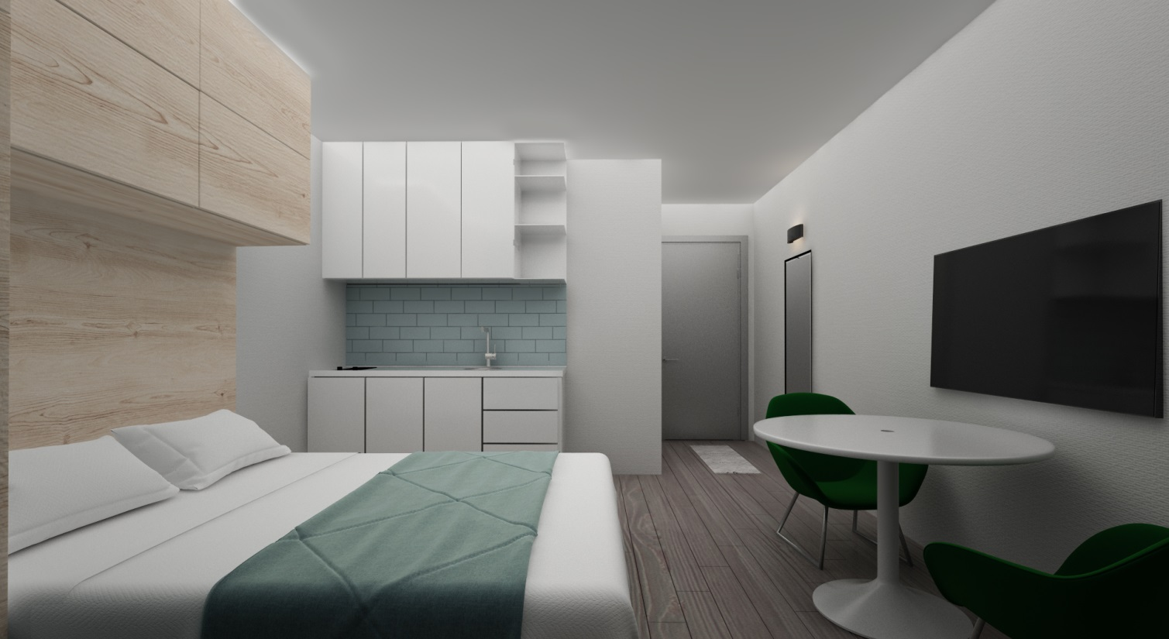
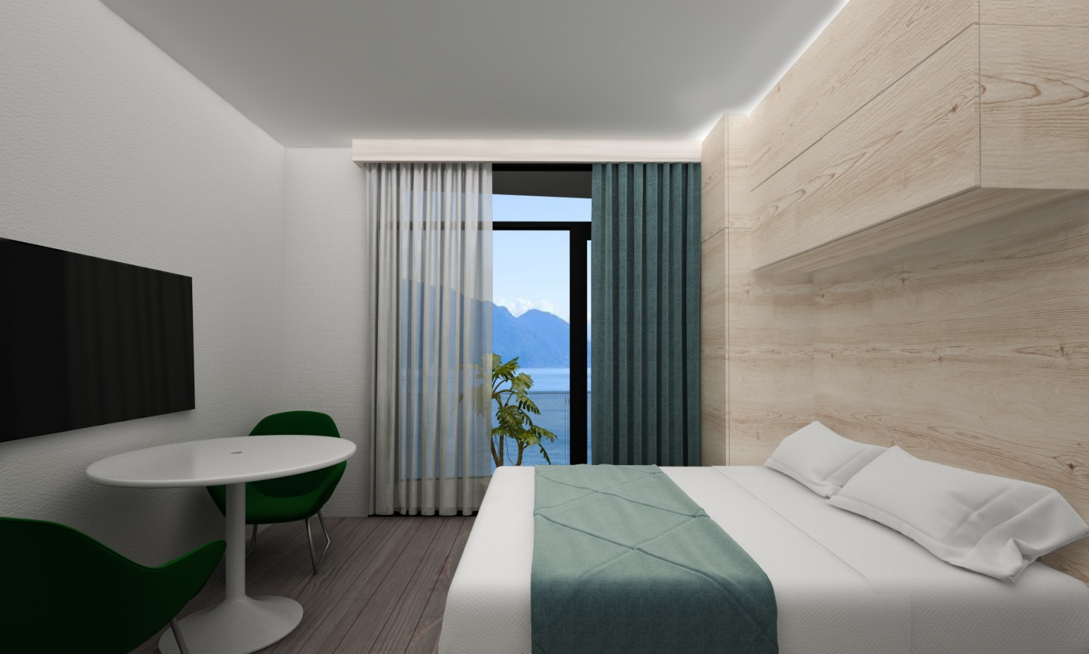
We care about your comfort.
25/27 sq.m. Studio type apartment. In one space you will find a kitchen corner and a bedroom.

Slide 7
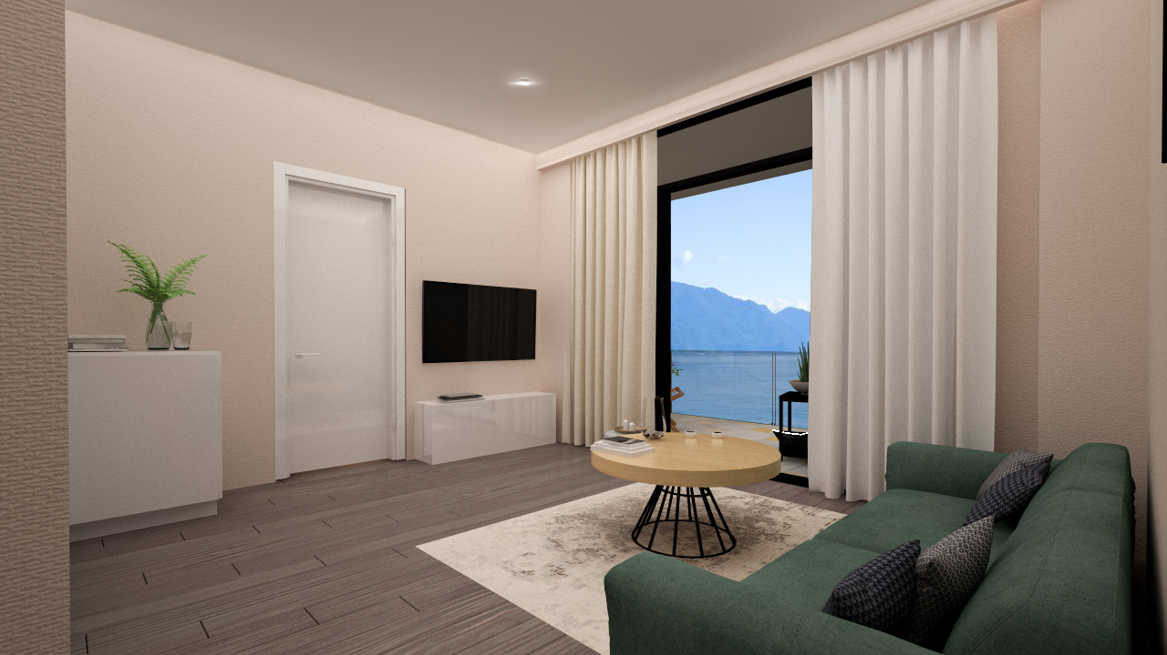
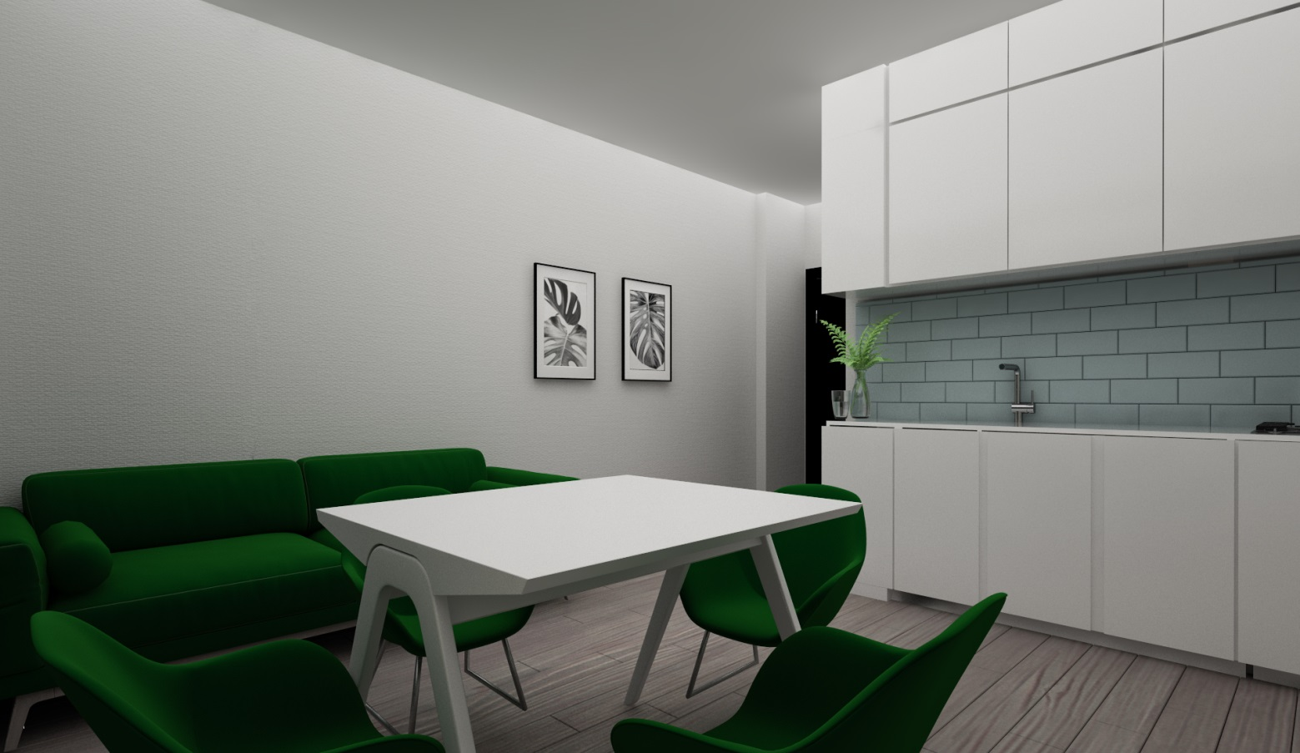
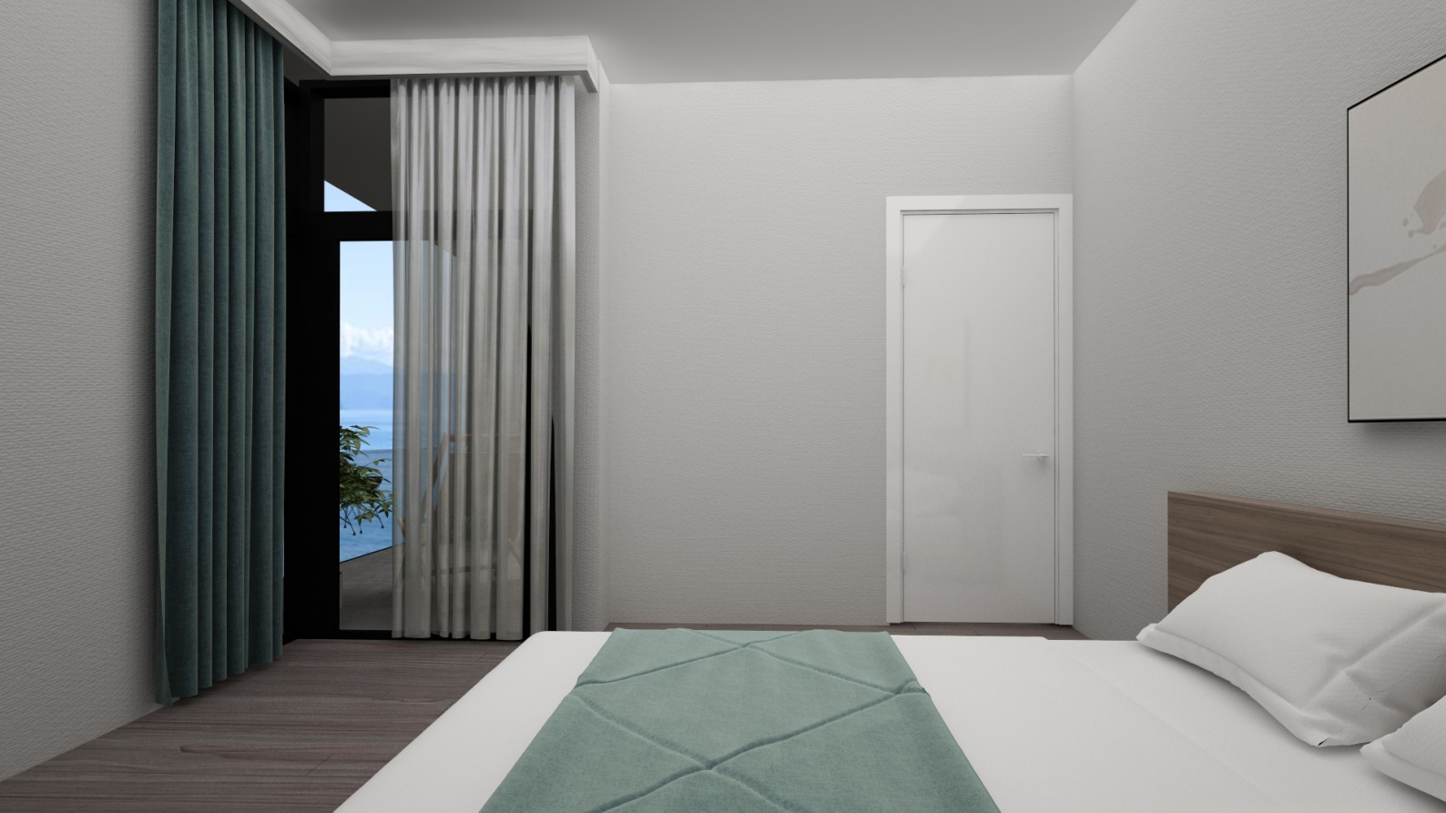
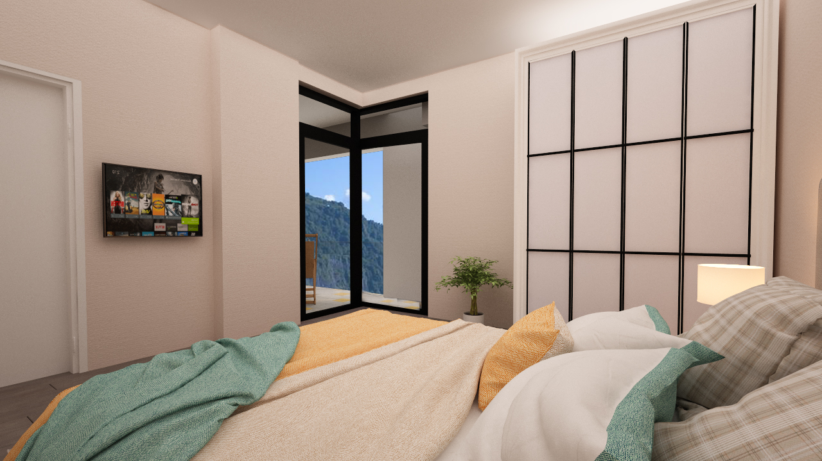
Living room: 16.3 sq.m. Bedrooms: 12.7 sq.m. Bathrooms: 4.2 sq.m. Terrace : 10.3 sq.m.
In the 44 sq.m. apartment you will find a living room and an isolated bedroom.

Slide 8
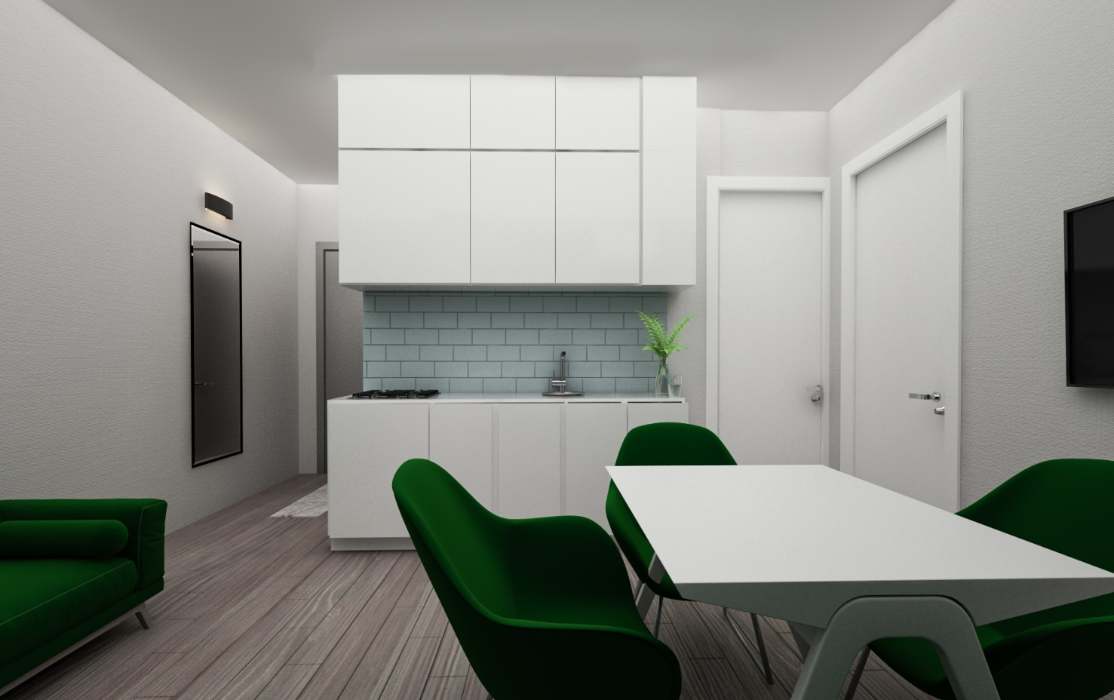
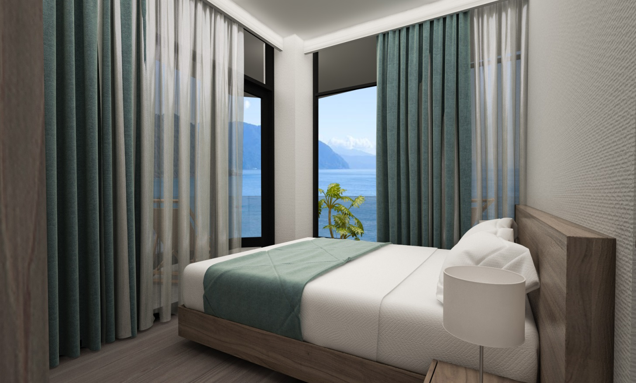
72 sq.m. Apartment, with living room and two isolated bedrooms.
Living room : 22.55
Bedroom 1: 11.02
Bedroom 2: 10.05
Bathroom : 4.5
Summer Terrace: 23.89

Slide 9
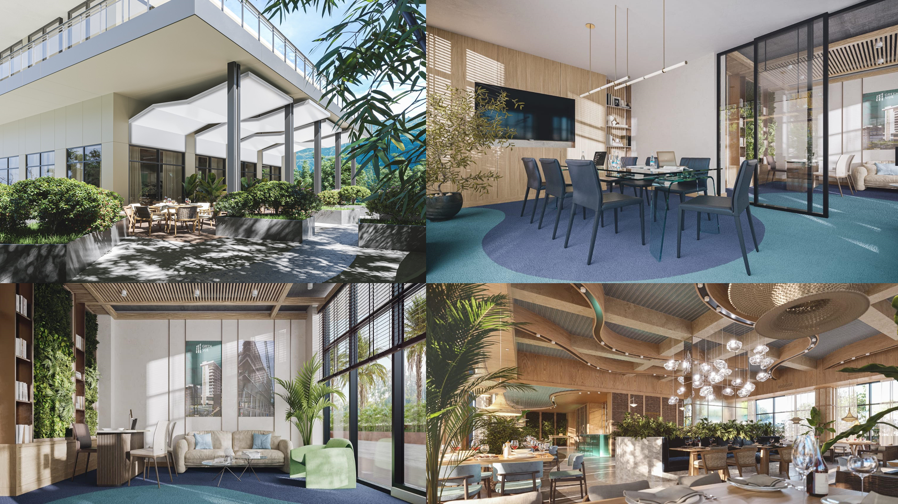

Slide 10
-1, 1, 2 - floor covers
-1 Floor - Underground parking
1st Floor – Reception
T – Technical floor
2nd floor - swimming pool, spa, gym.
Prices by floors
first floor 1600 $ Panorama 1650 $
second floor 1600 $ Panorama 1650 $
Third - Floor 1650 $ Panorama 1700 $
4-th floor 1700 $ Panorama 1750 $
5-th Floor 1750 $ Panorama 1800 $
6-th Floor 1800 $ Panorama 1850 $
7-th Floor 1850 $ Panorama 1900 $
8-th Floor 1900 $ - panorama Sold out
9 th- Floor 2000 $- panorama Sold out
10- Floor - Penthouse 2500 $

Slide 11
Thank you
for attention !

