Slide 1
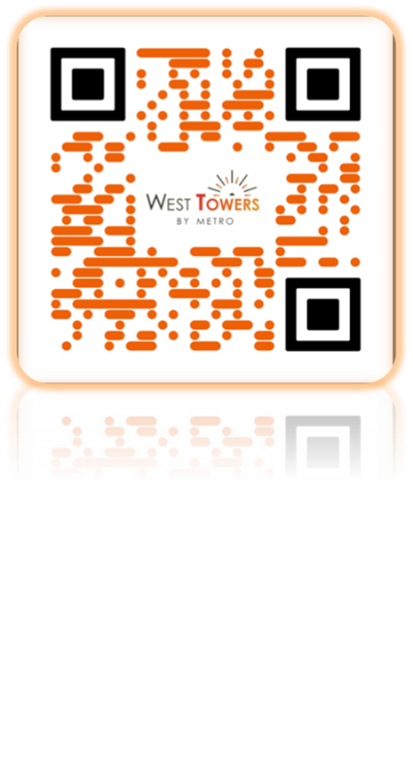

Slide 2
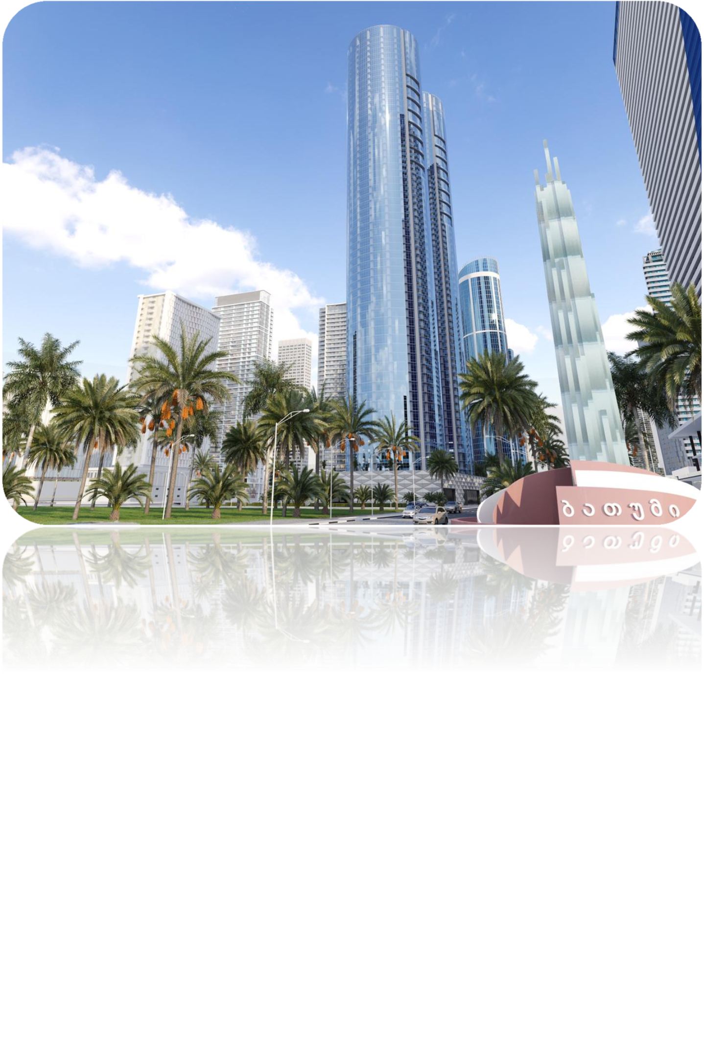
Shortly about De Group:
Real estate management-operation.
It is one of the daughter companies of JSC Metro Atlas Georgia.
Completion date is December, 2023

Slide 3
Shortly about “ METRO AVRASYA INVESTMENT GEORGIA’’
Company was founded in 2010 and his Priorities are:
Management of intercity bus stations, shopping centers, open fairs, show rooms Management-Operation
Hotel management-operation
Trade
Construction
Tourism
Medical tourism
Invest
Legal services
Financial services

Slide 4
INVESTMENTS IN GEORGIA–
*Metro Georgia; *Metro Intourist; *City travel; *Euphoria Sky Tower; *Metro City Apartments;
Metrocity Forum;
Stork IVF,
City Car,
City Hotel Batumi;
Goderdzi SKI Resort;
WEST TOWERS;
JASMIN;
Euphoria Hotel Batumi

Slide 5
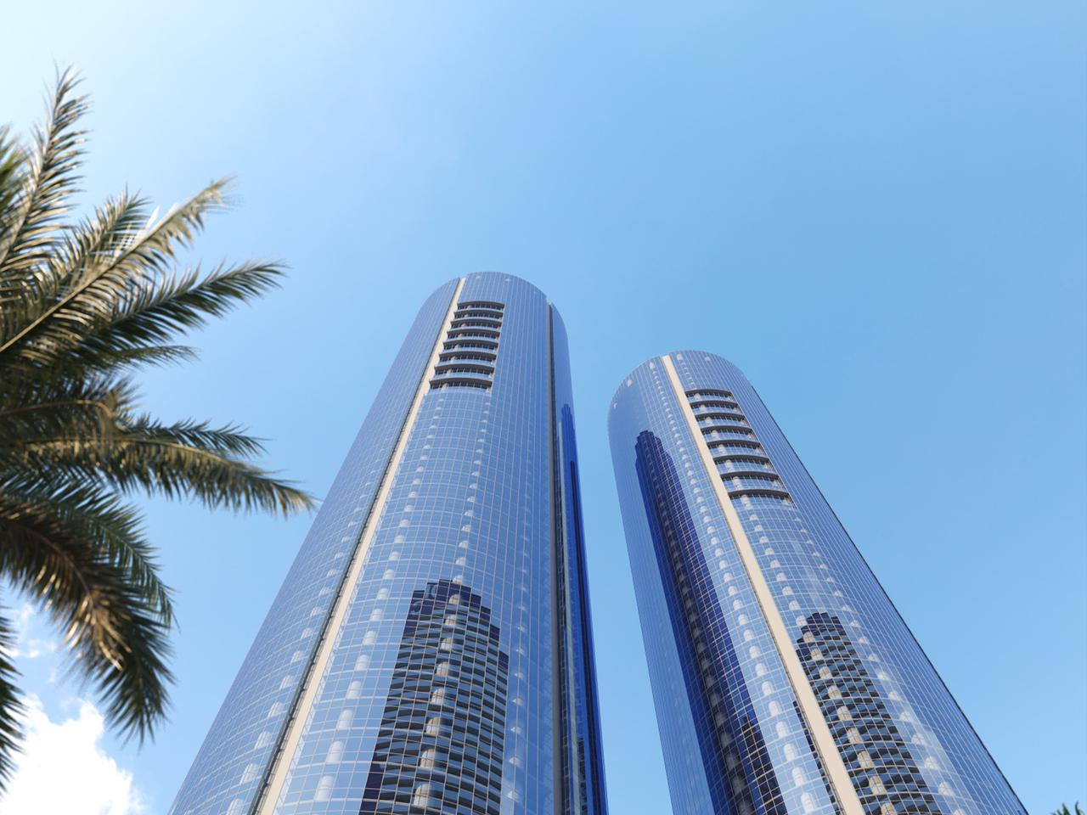
Description of a complex:
Shopping Mall
Underground parking
Two Blocks each with 60 floors
One of the biggest hotels in Georgia
1440 apartments

Slide 6
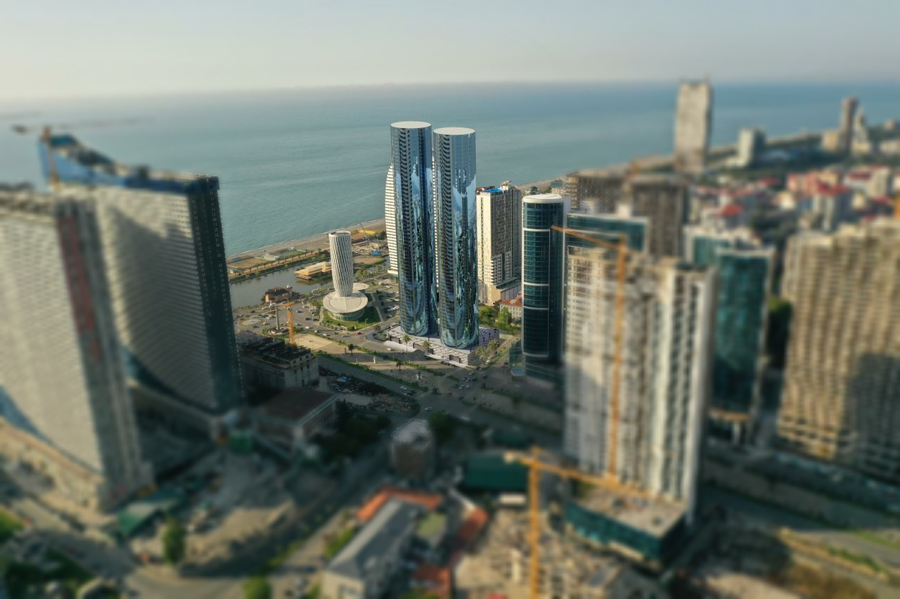
DELIVERY CONDITION: BLACK SHELL
PRICE: A block – 1500$
B block – 1200$

Slide 7
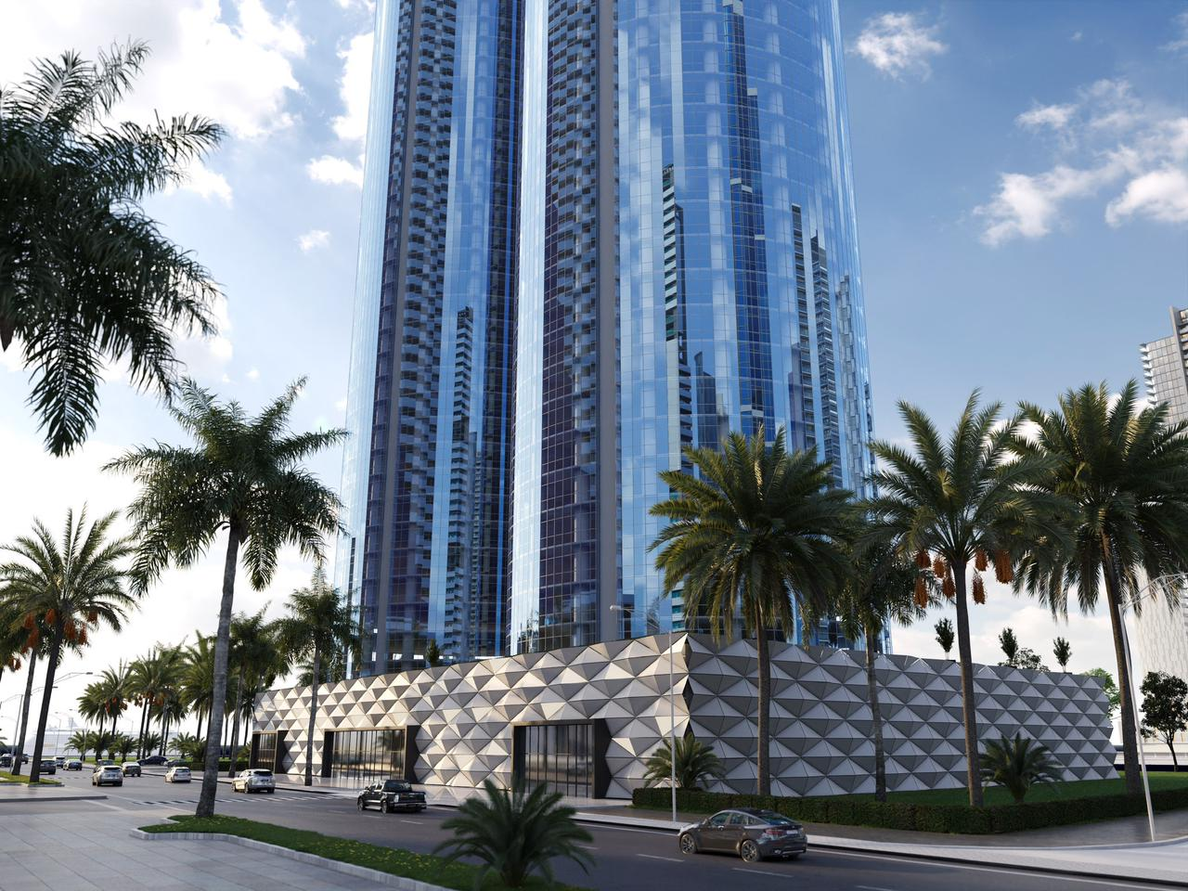
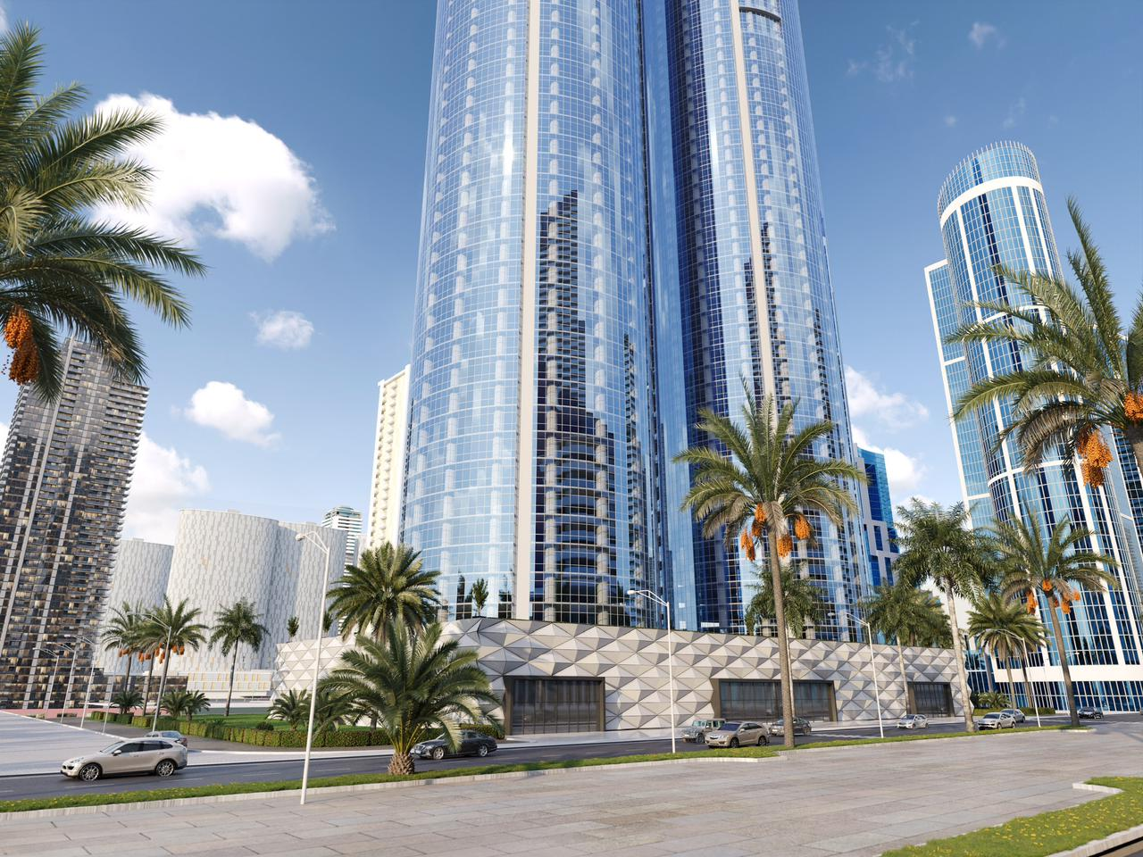

Slide 10
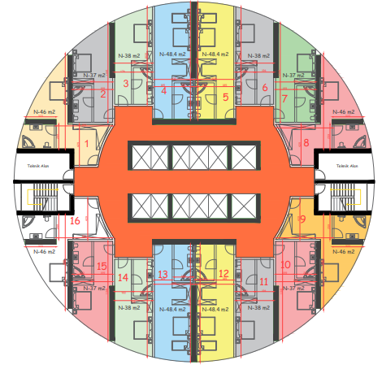

Slide 11
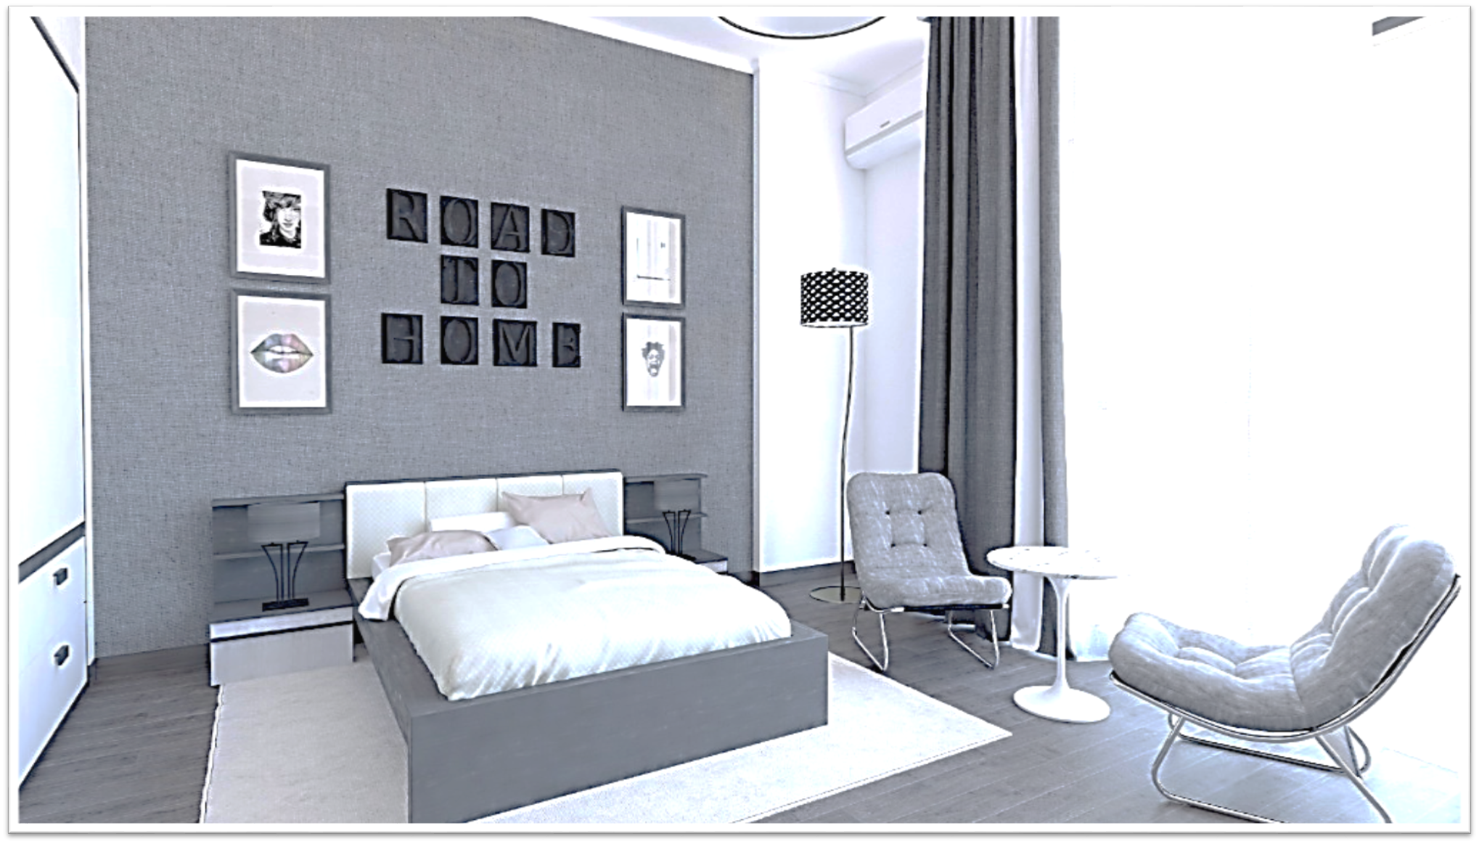
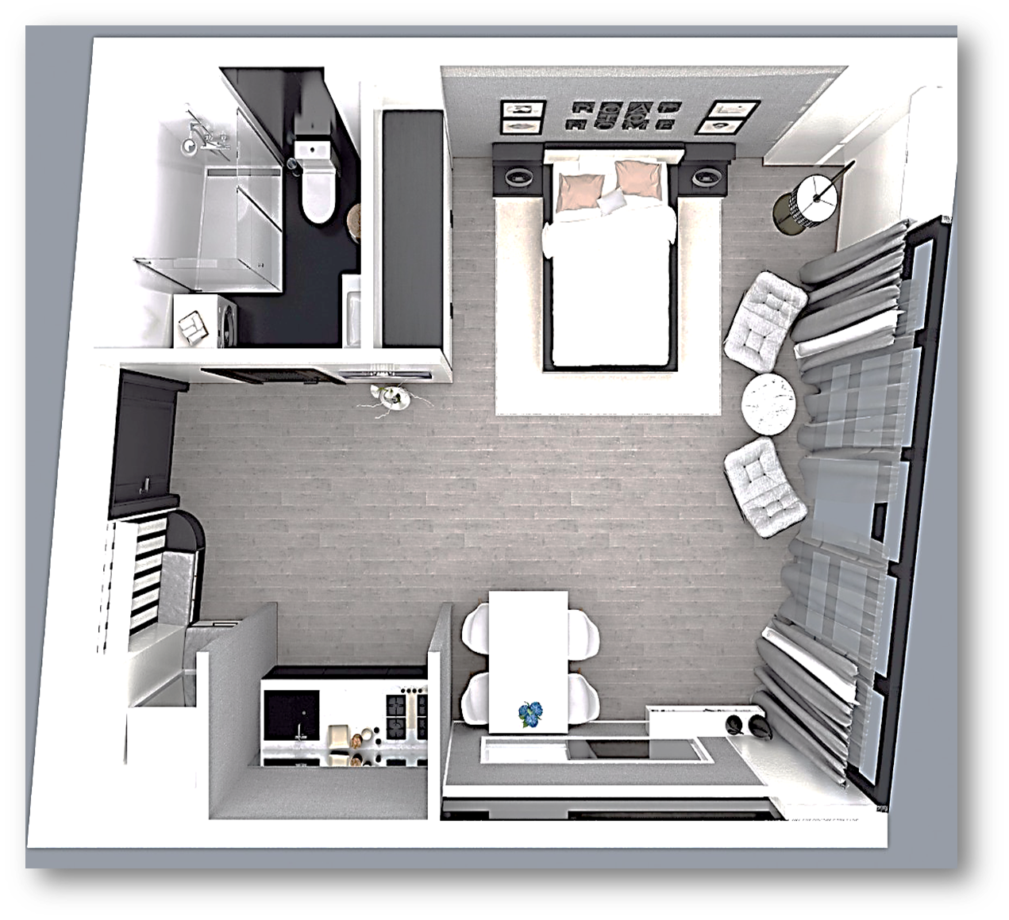
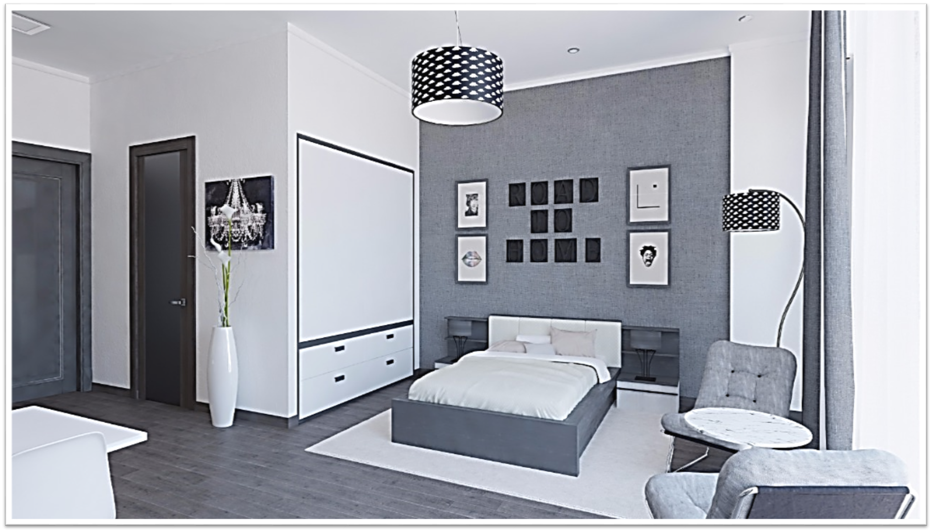
INVENTORY
Sofa
Armchairs
Table
Chairs
Double bed
Bedsides
Closet
AC
TV
Washing machine
fridge

Slide 12
FOR OUR COSTUMERS
DISCOUNT FOR OUR SERVICES
FINANCIAL – 10% DISICOUNT
LEGAL CONSULTANCY
SPECIAL DISCOUNT FOR OUR CUSTOMERS FROM APPLE STORE
CAR RENTING SERVICES
COVID 19 - PCR TESTS
ARTIFICIAL INSEMINATION CENTER STORK IVF
DISCOUNTS ON OTHER RESIDENTIAL PROJECTS
HOTEL ACCOMODATION AT EUPHORIA HOTELS
SOFTWARE SERVICES
RENOVATION / INETRIOR WORK SERVICES
INSURANCE SERVICES
PETROL SERVICES
HOUSEKEEPING SERVICES
TOURIST GUIDELINE
ASSISTANCE FOR GETTING THE RESIDENCE CARD
34%

Slide 13
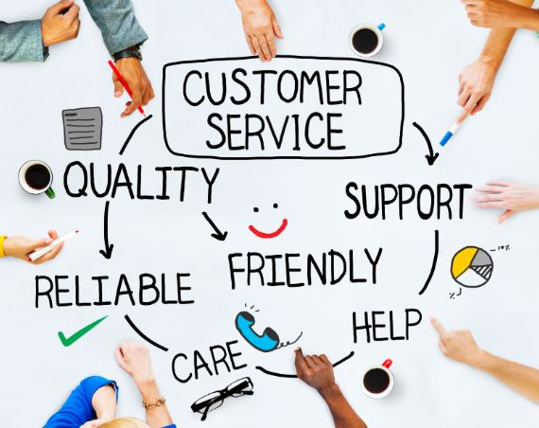
SERVICES
COMMON AREA AND VISITORS CONTROL
24/7 TECHNICAL SERVICE ASSISTANCE
24/7 SAFETY AND SECURITY
COMMON AREA CLEANING SERVICE
BUILDING MAINTENANCE SERVICE
COMMON AREA LIGHTENING SERVICE
SERVICE FEE 1$ PER 1M2

Slide 14
